Slide 1

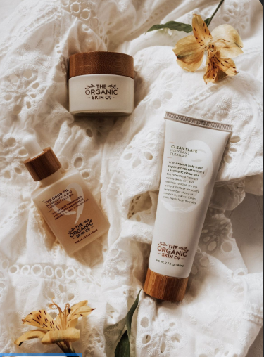
Eyai
Cyndiket
SENTIMENT ANALYSIS OF SKIN CARE PRODUCTS

Slide 2
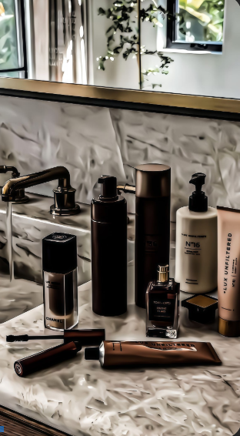
Members
LIONEL AJELITI
STANLEY MACHARIA
TABBY MIRARA
KAVATA MUSYOKA
AMOS KIPKOECH

Slide 3
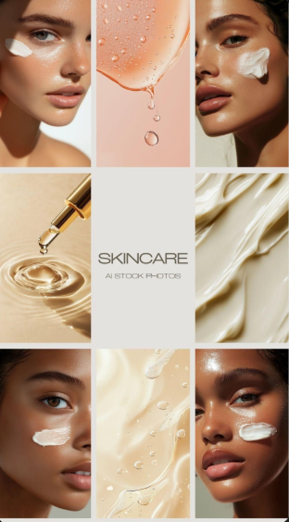

Business Problem
In the beauty and skincare market, user evaluations are a valuable yet underutilized source of consumer information. These evaluations frequently include comprehensive personal experiences with products, emphasizing their impact on different skin kinds, tones, and conditions. However, due to the unstructured and subjective nature of this data, companies, researchers, and potential customers find it challenging to properly assess sentiment or establish trends across enormous amounts of input.

Slide 4
Objectives
Main Objective: To perform sentiment analysis on customer reviews on products to enhance customer satisfaction.
To assess product categories and brand popularity to guide companies on future pricing
To assess the price range across various products to improve the affordability of products for customers.
To detect common keywords and phrases to highlight positive, neutral, and negative reviews on products to understand customer satisfaction and dissatisfaction.
To build a model that recommends products based on skin type, skin tone and price.

Slide 5
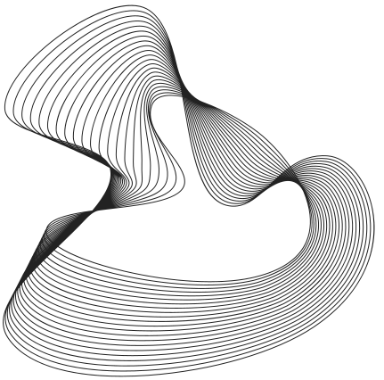
Stakeholders
Online stores that sell skin care products.
Companies that produce and sell skin care products.
Customers

Slide 6
Data understanding
The data was taken from Kaggle It contains information about beauty products from Sephora online store. It had 285412 rows and 19 columns, and some columns had missing values.
The following are the key features for the dataset:
Rating
Is recommended
Total feedback count
Total negative feedback count
Total positive feedback count
Review text
Review title
Skin tone
Skin type
Returns
Diversification
Portfolio
Preservation

Slide 7
Exploratory Data Analysis
Exploratory Data Analysis (EDA) helps you understand the structure, quality, and patterns within a dataset before modeling.

Slide 8

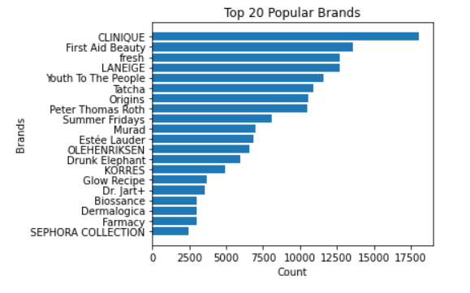
Popular Brands
CLINIQUE was the most popular in the dataset and SEPHORA COLLECTION was the least.

Slide 9
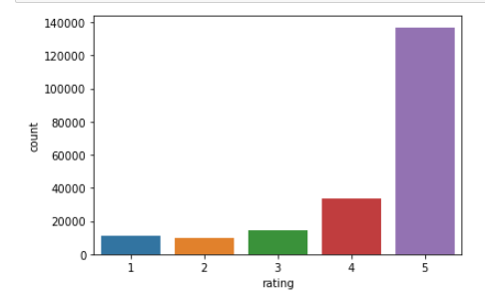
Rating Distribution
Most products are highly rated

Slide 10
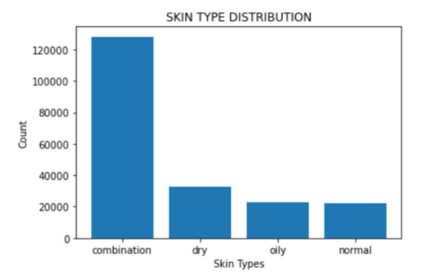
Skin Types Distribution
Majority of the population had combination and dry skin types

Slide 11
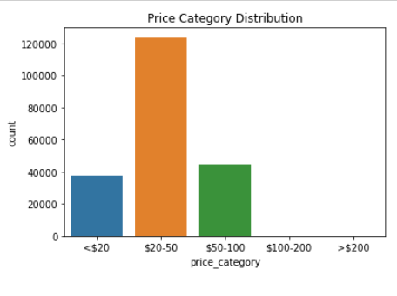
Price Category Distribution
Most products range between 20 50 dollars. This shows a big percentage of products are affordable

Slide 12
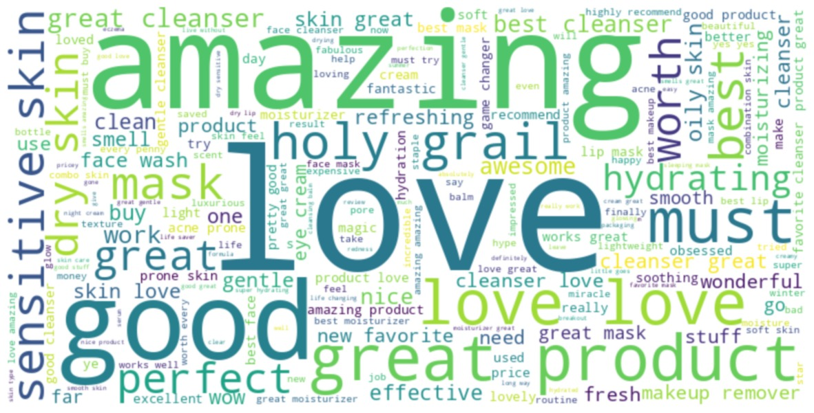
WordCloud for Positive Sentiments
Words like “Amazing,” “Love,” “Great,” and “Good” stand out.

Slide 13
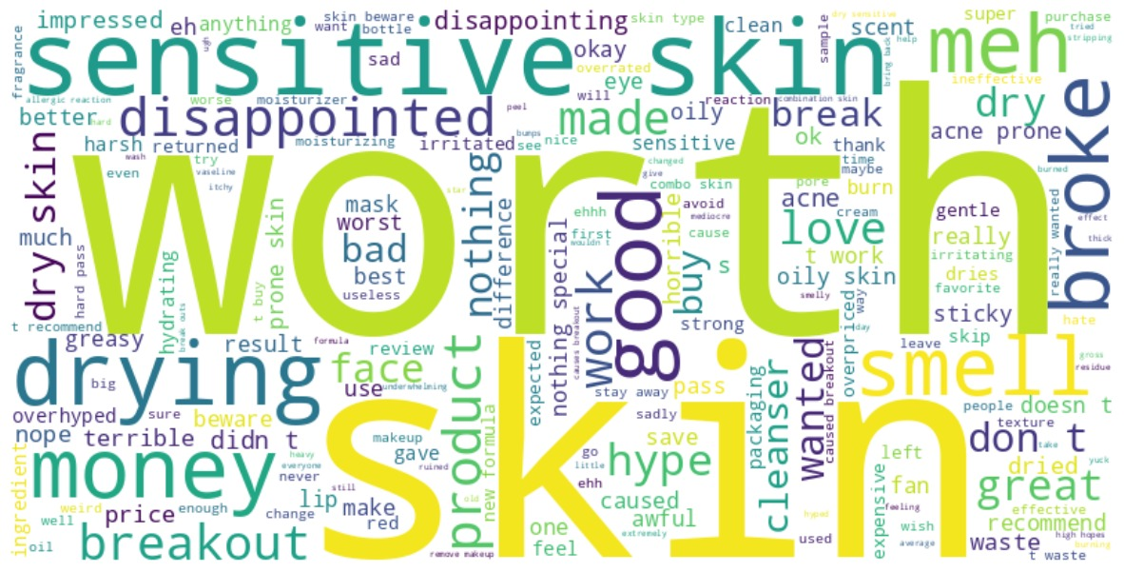
WordCloud for Negative Sentiments
Words like “worth,” “skin,” “sensitive,” “drying,” and “money” .

Slide 14
Modeling
Model | Accuracy | F1-Score | AUC
Logistic Regression | 0.95 | 0.87 | 0.98
Linear SVC | 0.95 | 0.87 | 0.98
Random Forest | 0.96 | 0.90 | 0.98
XG BOOST | 0.96 | 0.91 | 0.99
Accuracy - Shows how often the model is correct overall.
F1-Score - Shows how well the model balances being right when it says something is true and not missing important cases.
AUC - Area Under The Curve
Returns

Slide 15

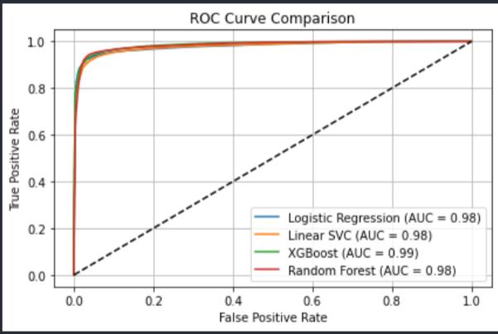
Model Evaluation
From the diagram, XGBOOST has the highest AUC of 0.99 thus has the best classification performance while the other models have 0.98 showing strong classification power but XGBOOST is the best model.

Slide 16
Conclusion
We picked XGBOOST because it was the best performing model for its excellent classification power as it provides the most accurate trade-off between sensitivity (recall) and specificity.
Returns

Slide 17
Recommendations
We recommend:
Personalized Product Displays for online stores.
DEI(Diversity, Equity, and Inclusion) Transparency for companies.
Promotional Targeting for online stores.
Generate educational content for customers on the range and pricing of products
Product use
Returns

Slide 18
Thank You
Gerente General

